Slide 1

Navigating Tomorrow's Trends Today
July 2025
Olivier Ponti Director of Intelligence and Marketing - Amadeus (formerly ForwardKeys)
Amadeus. It’s how travel works better.

Slide 2
ForwardKeys data captures and reflects the entire traveller journey
SUPPLY
DEMAND
FUTURE
Schedules
Searching
Booking
Arriving
Staying
Departing
Future
Seat Capacity
Flight Searches
Actual Air Reservations + Actual Air Tickets + Total Air Market
Forward-looking capacity
Amadeus. It’s how travel works better.

Slide 3
Airlines increase available seats for 2025
Flown and Forecasted air supply for overseas flights between January and June 2025; vs previous year
Worldwide international air connectivity
H1 2024 vs 2024
+7%ꜛ
The Americas
Europe
Africa & Middle East
Asia Pacific
H1 2025:
+3% vs 2024
+7% vs 2024
+5% vs 2024
+10% vs 2024
Source: Amadeus (formerly ForwardKeys) Air Supply
Amadeus. It’s how travel works better.

Slide 4
Airlines increase available seats for 2025
Flown and Forecasted air supply for overseas flights between January and June 2025; vs previous year
Worldwide international air connectivity
H1 2024 vs 2024
+7%ꜛ
Summer 2025 vs 2024
(July and August)
+7%ꜛ
The Americas
Europe
Africa & Middle East
Asia Pacific
H1 2025:
+4% vs 2024
+6% vs 2024
+5% vs 2024
+10% vs 2024
Summer 2025:
+7% vs 2024
+6% vs 2024
+6% vs 2024
+8% vs 2024
Source: Amadeus (formerly ForwardKeys) Air Supply
Amadeus. It’s how travel works better.

Slide 5

Americas Focus: Air Supply growth relatively even
Forecasted air supply for overseas flights to the Americas between July and August 2025; vs previous year
North America
+5% vs 2024
7%
13%
The Caribbean
+7% vs 2024
Seats
(% share)
17%
64%
Central America
+12% vs 2024
South America
+12% vs 2024
Source: Amadeus (formerly ForwardKeys) Air Supply
Amadeus. It’s how travel works better.

Slide 6
Strong air connectivity is key for emerging destinations
Forecasted air supply for overseas flights to the Americas between July and August 2025; vs previous year
Top Performing Emerging Destinations* | % Share | Year-over-Year
Bonaire, Saint Eustatius, Saba | 0.1% | +39%
Antigua and Barbuda | 0.2% | +13%
Guyana | 0.2% | +12%
Paraguay | 0.2% | +11%
Bermuda | 0.2% | +10%
Nicaragua | 0.2% | +8%
Belize | 0.1% | =0%
Saint Lucia | 0.2% | =0%
*Emerging destinations = destinations that represent between 0.1% and 0.25% share
Source: Amadeus (formerly ForwardKeys) Air Supply
Amadeus. It’s how travel works better.

Slide 7
Canada and Europe are showing strong intent for travel to Belize
Flight Searches made for travel to Belize between July and August 2025, as of 20 June; vs previous year
Top Performing Origin Markets* | % Share | Year-over-year variation
Canada | 7.3% | +85%
Belgium | 1.1% | +61%
Austria | 0.5% | +32%
Italy | 2.0% | +21%
Guatemala | 2.4% | +19%
Panama | 0.8% | +15%
Brazil | 0.6% | +14%
Spain | 1.8% | +9%
Switzerland | 0.9% | =0%
*Considering markets that represent more than 0.5% share
Source: Amadeus (formerly ForwardKeys) Flight Searches
Amadeus. It’s how travel works better.

Slide 8
Europe focus: Connectivity and key transfer points
On-the-books arrivals from Europe to Belize between July and August, as of 21 June
Key Transfer Airports for European travellers | % Share
Guatemala City | 53.6%
Houston | 13.8%
Atlanta | 7.8%
Cancun | 6.8%
Miami | 5.1%
Source: Amadeus (formerly ForwardKeys) Air Reservations
Amadeus. It’s how travel works better.

Slide 9






Majority of Top Airlines Increase Seat Capacity to Belize
Forecasted air supply for overseas flights to Belize between July and August 2025; vs previous year
31.1% share of seats
-10% vs 2024
10.1% share of seats
+14% vs 2024
28.4% share of seats
=0% vs 2024
+1 new connection vs 2024
6.0% share of seats
+1% vs 2024
11.1% share of seats
+15% vs 2024
4.8% share of seats
+25% vs 2024
Source: Amadeus (formerly ForwardKeys) Air Supply
Amadeus. It’s how travel works better.

Slide 10
Identifying Opportunities
Amadeus. It’s how travel works better.

Slide 11
Identifying opportunities: Underserved vs underused routes
Seat Capacity and Flight Searches for travel between January and May 2025 to Belize
Under-used Routes
Higher proportion of available seats compared with flight searches
Under-served Routes
Higher proportion of flight searches compared with available seats
Source: Amadeus (formerly ForwardKeys) Forecasted Seat Capacity & Flight Searches
Amadeus. It’s how travel works better.

Slide 12
Identifying opportunities: Underserved vs underused routes
Seat Capacity and Flight Searches for travel between January and May 2025 to Belize
Under-used Routes
Under-served Routes
Source: Amadeus (formerly ForwardKeys) Forecasted Seat Capacity & Flight Searches
Amadeus. It’s how travel works better.

Slide 13
Identifying opportunities: Underserved vs underused routes
Seat Capacity and Flight Searches for travel between January and May 2025 to Belize
Under-used Routes
Under-served Routes
Source: Amadeus (formerly ForwardKeys) Forecasted Seat Capacity & Flight Searches
Amadeus. It’s how travel works better.

Slide 14
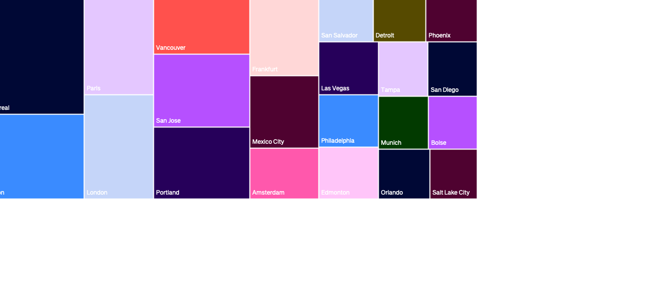
Identifying opportunities: Unserved Routes
Flight Searches for travel between January and May 2025 to Belize, with 0 direct connections
Source: Amadeus (formerly ForwardKeys) Forecasted Seat Capacity & Flight Searches
Amadeus. It’s how travel works better.

Slide 15
Destination Affordability Hotel Rates
Amadeus. It’s how travel works better.

Slide 16
Belize high-end hotel fares are more affordable vs the Caribbean avg
Average Daily Rate (USD) for high-end hotel rooms between June 2024 and June 2025
Source: Demand 360
Amadeus. It’s how travel works better.

Slide 17
Understand your market Traveller Booking Channels
Amadeus. It’s how travel works better.

Slide 18
Different markets show varying trends for booking their trips
Distribution Channels for international arrivals to Belize between January 2024 and May 2025
U.S.A.
Canada
Source: Amadeus (formerly ForwardKeys) Air Reservations
Amadeus. It’s how travel works better.

Slide 19
Understand your market Lead times
Amadeus. It’s how travel works better.

Slide 20
How travel planning varies by market
Leadtimes for searches made from key markets to Belize between January and May 2025
Source: Amadeus (formerly ForwardKeys) Flight Searches
Amadeus. It’s how travel works better.

Slide 21
How travel planning varies by market
Leadtimes for searches made from the U.S.A. to Belize between January and May 2025
Top 10 most searching US markets
Source: Amadeus (formerly ForwardKeys) Flight Searches
Amadeus. It’s how travel works better.

Slide 22
How travel planning varies by market
Leadtimes for searches made from the U.S.A. to Belize between January and May 2025
27% of searches made more than 90 days in advance
Top 10 most searching US markets
43% of searches made more than 90 days in advance
Source: Amadeus (formerly ForwardKeys) Flight Searches
Amadeus. It’s how travel works better.

Slide 23
Tackling Seasonality
Amadeus. It’s how travel works better.

Slide 24
Destination Comparison: Contrasts in seasonal connectivity
Seat Capacity for overseas flights arriving to Belize and Antigua and Barbuda in 2024 and 2025
Low-Season:
Mid-Aug till Mid-Nov
Source: Amadeus (formerly ForwardKeys) Air Supply
Amadeus. It’s how travel works better.

Slide 25
Who visited Antigua and Barbuda in the low season?
Overseas arrivals to Antigua and Barbuda between 19 Aug 2024 and 17 Nov 2024
U.S.A. 44.95%
United Kingdom 24.6%
Saint Kitts and Nevis 6.0%
Canada 5.5%
Dominica 2.8%
Aruba 2.2%
Montserrat 1.7%
St. Lucia 1.6%
Trinidad and Tobago 1.6%
Barbados 1.5%
Source: Amadeus (formerly ForwardKeys) Total Air Market
Amadeus. It’s how travel works better.

Slide 26
Who visited Antigua and Barbuda in the low season?
Overseas arrivals to Antigua and Barbuda between 19 Aug 2024 and 17 Nov 2024
Historical Arrivals
Flight Searches
Travel Intent
Origin Markets to watch out for in 2025
U.S.A. 44.95%
United Kingdom 24.6%
Saint Kitts and Nevis 6.0%
Canada 5.5%
Dominica 2.8%
Aruba 2.2%
Montserrat 1.7%
St. Lucia 1.6%
Trinidad and Tobago 1.6%
Barbados 1.5%
Top Performing Markets* | Var vs 2024
Puerto Rico | +40%
Canada | +21%
Dominican Republic | +9%
Switzerland | +3%
Source: Amadeus (formerly ForwardKeys) Total Air Market
Amadeus. It’s how travel works better.

Slide 27
Who visited Belize in the low season?
Overseas arrivals to Antigua and Barbuda between 19 Aug 2024 and 17 Nov 2024
Top Origin Markets | Air Visitors (% Share)
U.S.A. | 83.0%
Guatemala | 3.8%
Canada | 3.0%
United Kingdom | 2.0%
Honduras | 1.9%
Panama | 1.5%
Netherlands | 0.5%
Trinidad and Tobago | 0.4%
Mexico | 0.4%
Italy | 0.3%
Source: Amadeus (formerly ForwardKeys) Total Air Market
Amadeus. It’s how travel works better.

Slide 28
Intent to travel to Belize during the upcoming low-season
Flight Searches made for travel between 18 Aug and 16 Nov 2025 to Belize; var vs 2024
Top Performing Origin Markets* | Var vs 2024
Canada | +111%
Belgium | +69%
Panama | +30%
Costa Rica | +16%
Spain | +5%
Mexico | +4%
Austria | +4%
Guatemala | +2%
*considering destinations that represent more than 0.5% share
Source: Amadeus (formerly ForwardKeys) Flight Searches
Amadeus. It’s how travel works better.

Slide 29
Intent to travel to Belize during the upcoming low-season
Flight Searches made for travel between 18 Aug and 16 Nov 2025 to Belize; var vs 2024
Top Performing Origin Markets* | Var vs 2024 | Direct Connections Y/N
Canada | +111% | Y
Belgium | +69% | N
Panama | +30% | Y
Costa Rica | +16% | N
Spain | +5% | N
Mexico | +4% | Y
Austria | +4% | N
Guatemala | +2% | Y
*considering destinations that represent more than 0.5% share
Source: Amadeus (formerly ForwardKeys) Flight Searches & Air Supply
Amadeus. It’s how travel works better.

Slide 30
Traveller Profiles: Singles and Couples dominate
Air Visitors arriving to Belize between 19 Aug 2024 and 17 Nov 2024; var vs 2023
Traveller Group Size (% share)
Traveller Cabin Class
Belize
Antigua and Barbuda
Belize
Antigua and Barbuda
Singles
38.1%
27.7%
Couples
43.5%
55.0%
Families
13.4%
13.9%
(3-5 pax)
Groups
4.9%
3.5%
(6+ pax)
Economy
Premium
Source: Amadeus (formerly ForwardKeys) Total Air Market
Amadeus. It’s how travel works better.

Slide 31
Take-Aways
Amadeus. It’s how travel works better.

Slide 32
1 Air connectivity is key to unlocking opportunities
Amadeus. It’s how travel works better.

Slide 33
2 Broadening visitor segments builds market resilience
Amadeus. It’s how travel works better.

Slide 34
3 The low season is prime time for growth
Amadeus. It’s how travel works better.

Slide 35
4 Travel data is critical for smarter decisions
Amadeus. It’s how travel works better.

Slide 36

Thank you!
Olivier Ponti
Director of Intelligence and Marketing
Amadeus (formerly ForwardKeys)
olivier.ponti@amadeus.com
Amadeus. It’s how travel works better.

